Slide 1
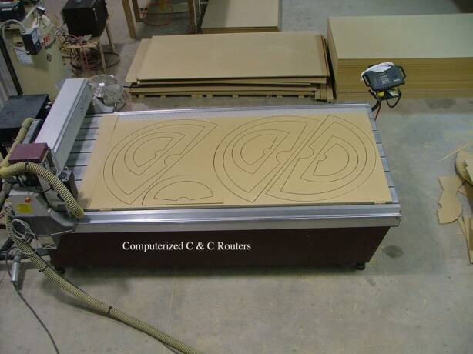
American Arches
America’s Premium Custom Arch Manufacturer
Using Computerized Equipment and Commercial Systems
A dedicated manufacturer of only Arches and Specialty Shaped Indoor Window Products. We offer an exclusive line of Energy Efficient Products at Economical Prices for the professional industry. American Arches is centrally located in the US and is staffed by skilled by craftsman operating computer-controlled routers that create unique products such as our Non-Movable Sunburst, Slatburst tm, Blackout Arch and the Movable Slatburst tm.
American Arches are custom designed products with the smartest solutions from the highest quality material on the market today! No templates required*. Easy installation without brackets or nails. Painted to match several interior paint colors!
*No template required in most cases

Slide 3
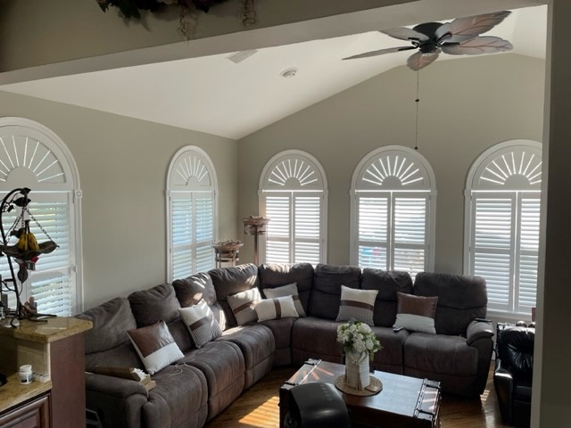
Custom Non-Movable
Sunburst Arches & Eyebrows
(More Light) generally used on north and south facing windows
1/4" openings between slats, block's out approx. 85% of direct sunlight

Slide 4
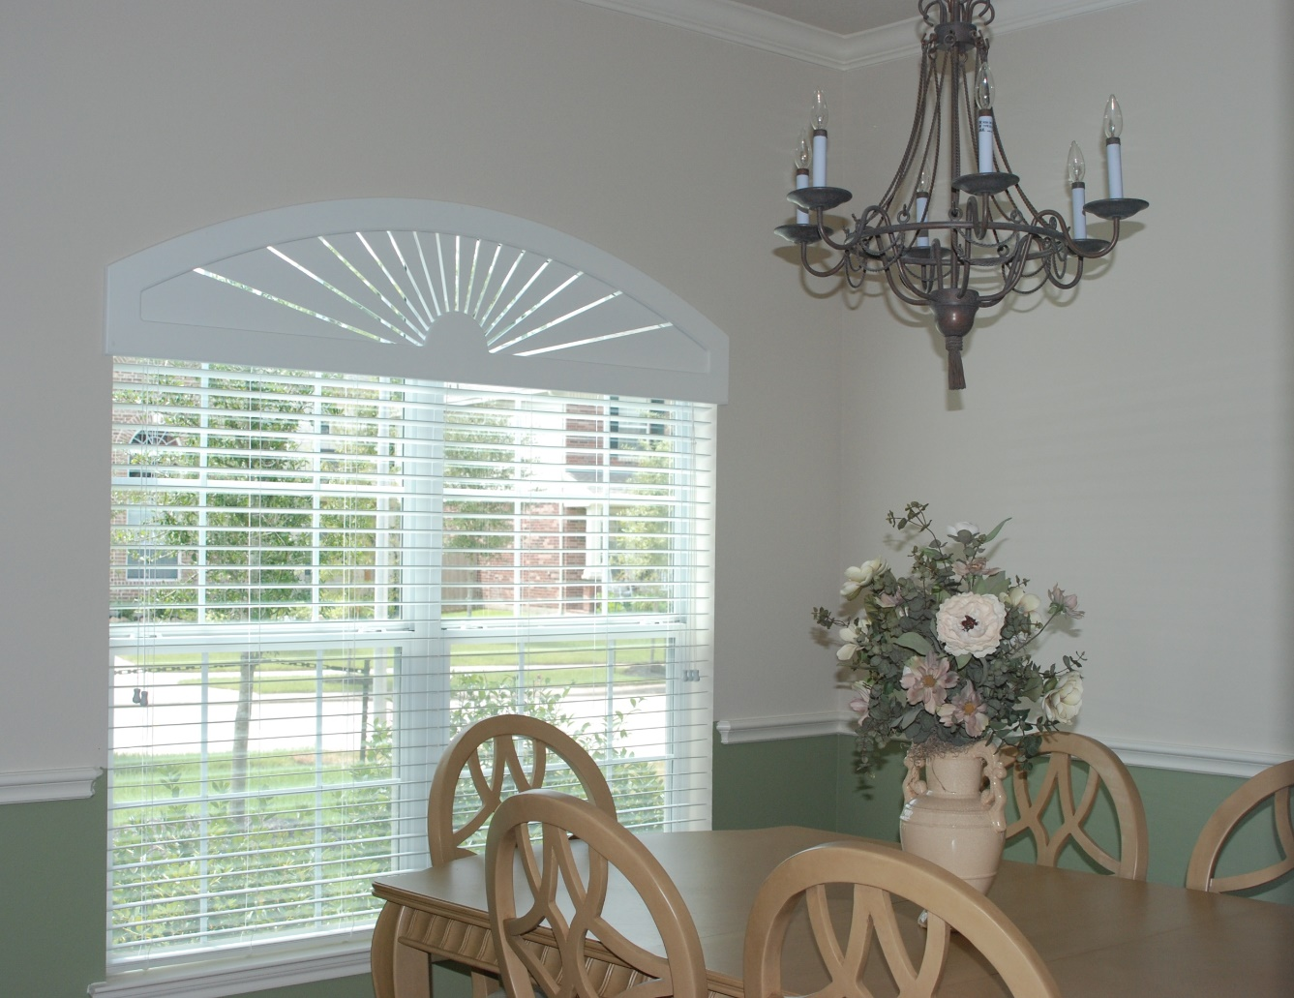
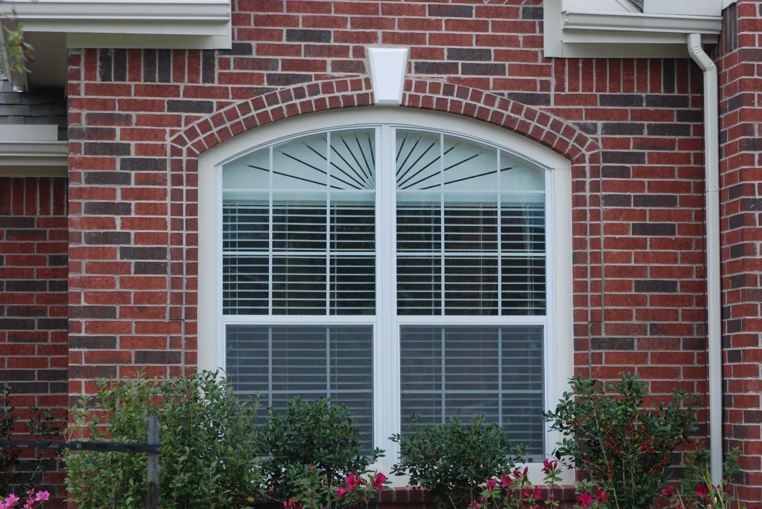
Custom Non-Movable
Slatburst tm
Arches & Eyebrows
(Less Light) generally used on east and west facing windows 1/8" angled openings between slats blocks approx. 92% of direct sunlight

Slide 5
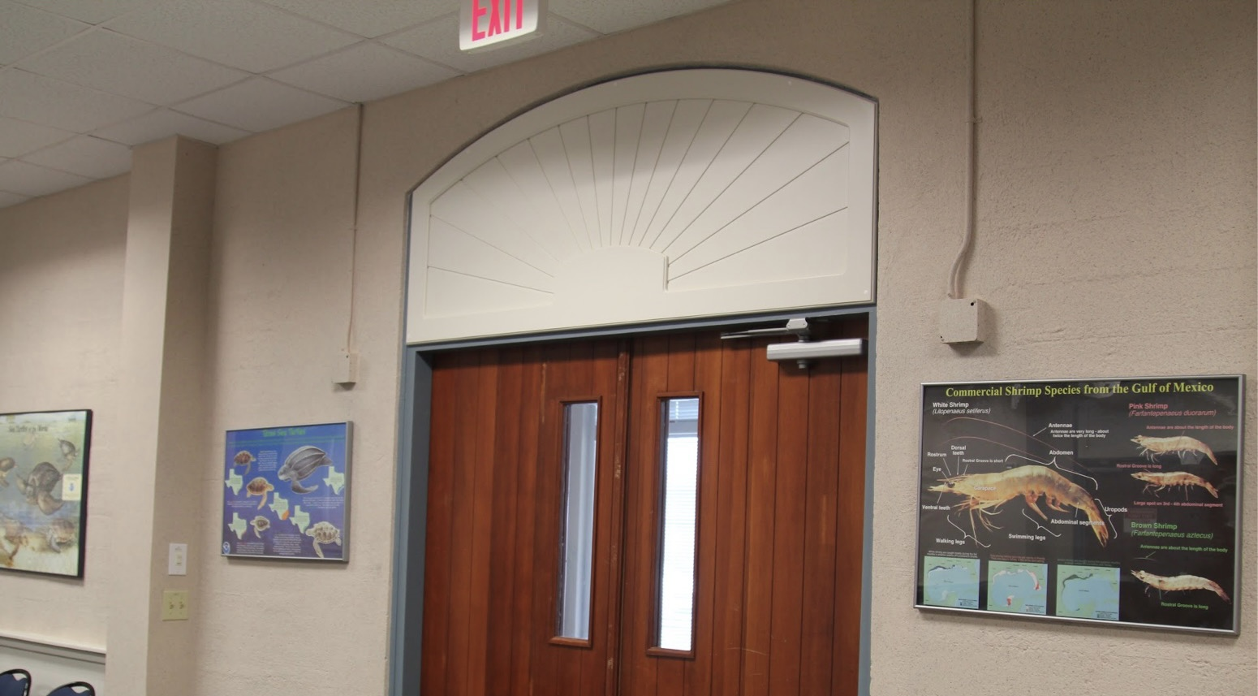
Custom
Non-Movable
Blackout
Arches & Eyebrows
(No light) generally used in bedrooms, baby rooms ,and TV rooms Resembles the sunburst Arch except the 1/4" groves are not completely cut through 100% energy efficient, a great treatment to darken any room. Place over any window or door to have today's Arched window look

Slide 6
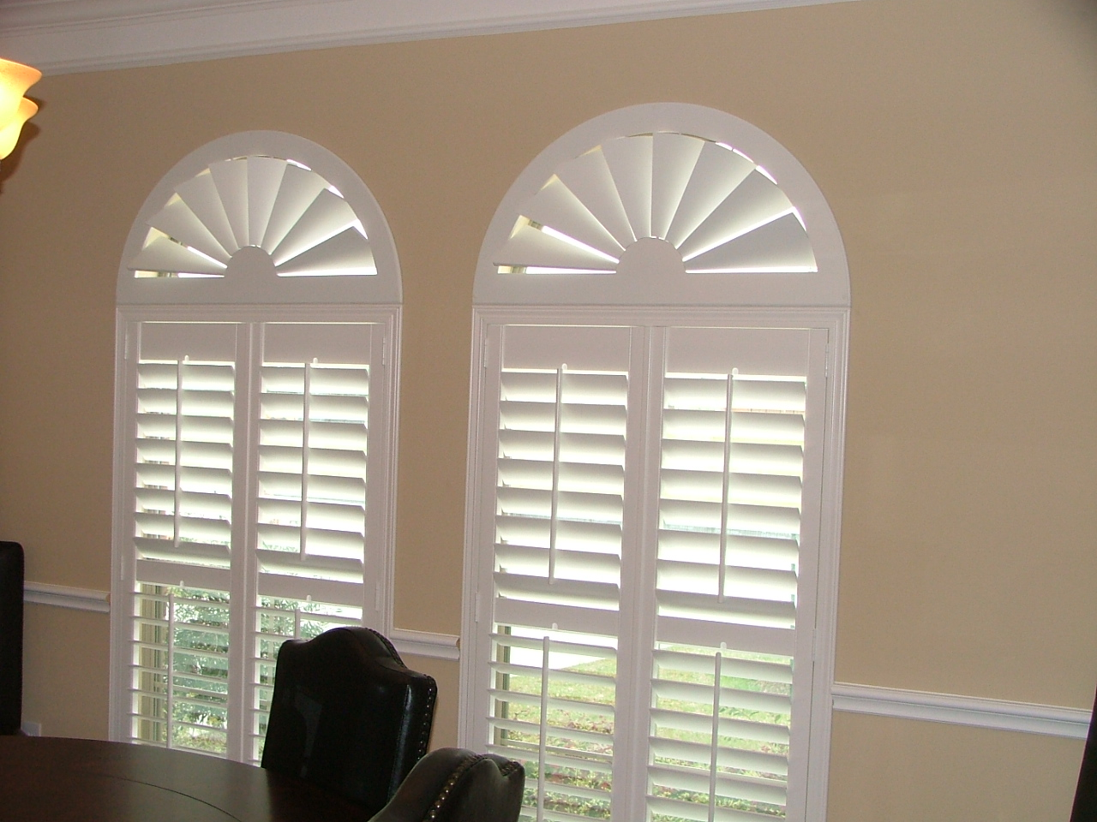
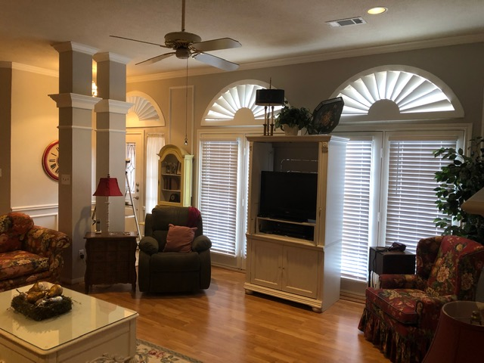
Custom
Operable
Arches & Eyebrows
Fully adjustable Operable Slatburst Arch tm
Offered in many custom shapes and
sizes
Manufactured with quality shutter hardware
Arches over 48" are fabricated with additional fixed center support a maybe manufactured in 2 pieces to prevent freight damage

Slide 7
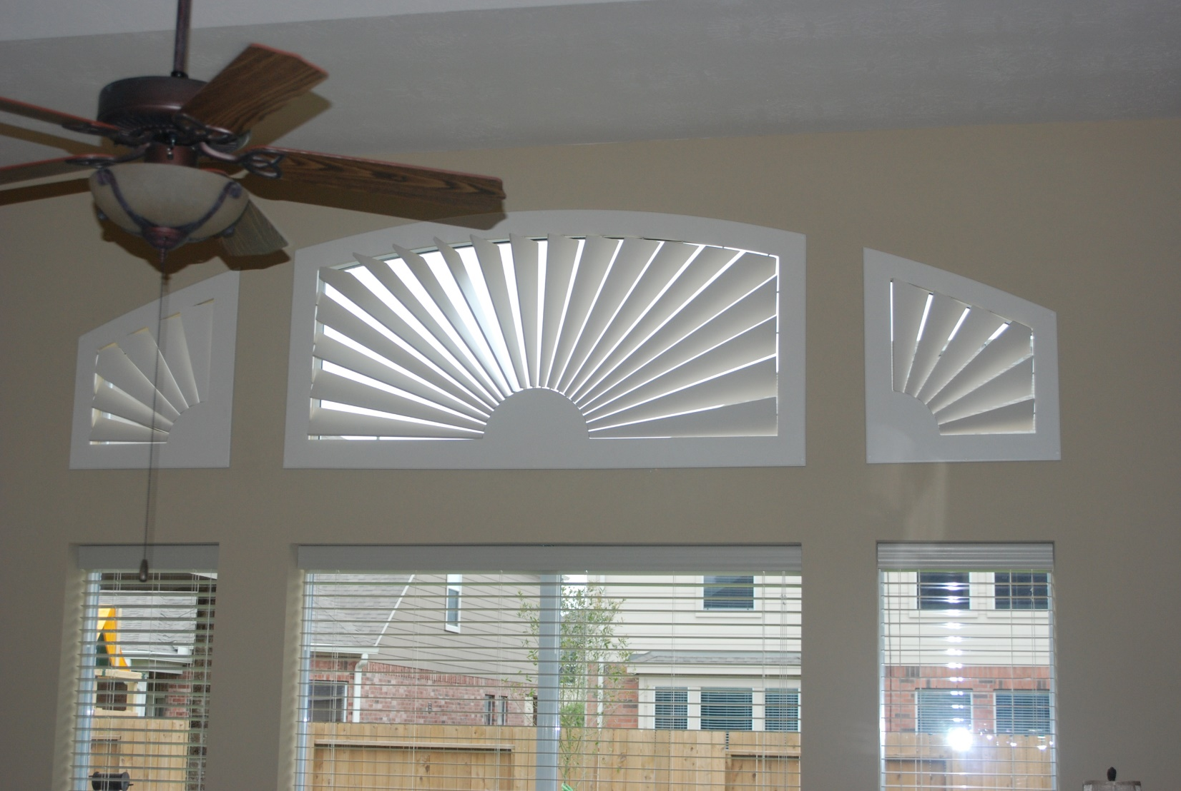
Custom Specialty Shaped
Arches & Eyebrows

Slide 8
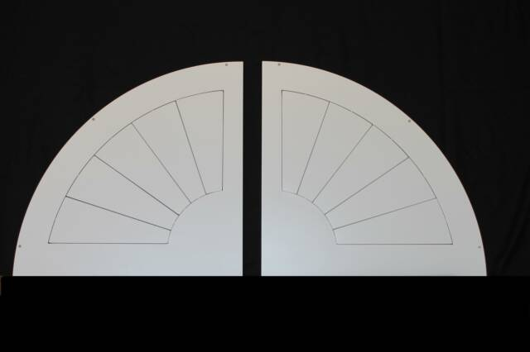
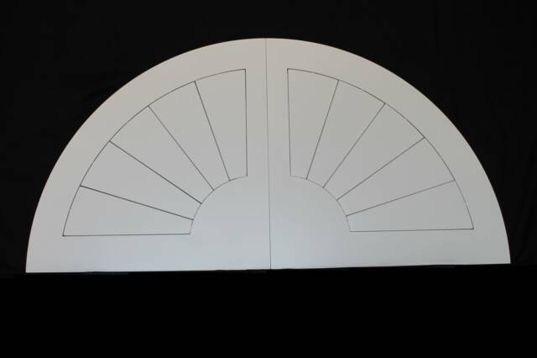
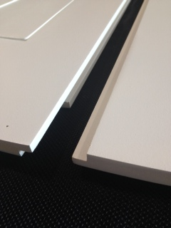
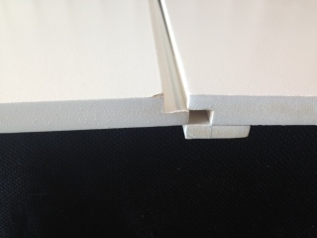
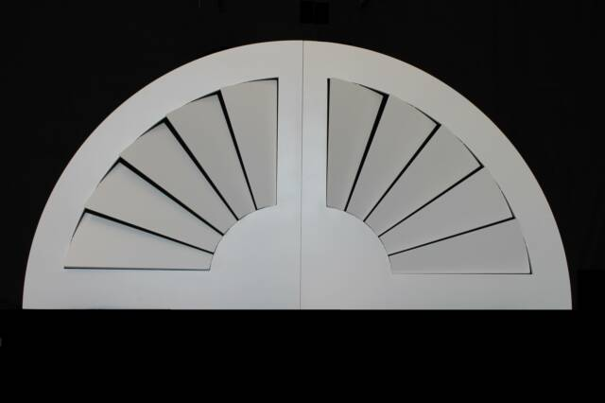
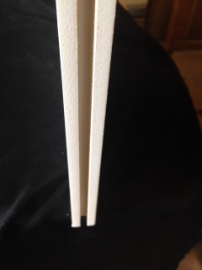
2 Piece Custom Arches & Eyebrows over 49”
Operable Arches over 49" will be shipped in two pieces(easier to install!) to prevent freight damages. Assembled by just sliding together.
New Tongue & Groove Design

Slide 9
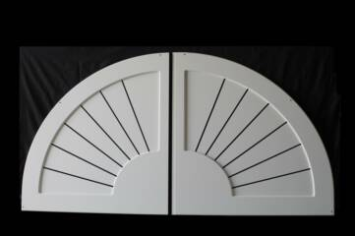
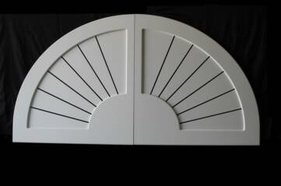
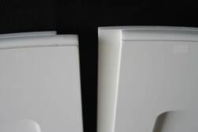
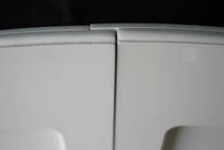
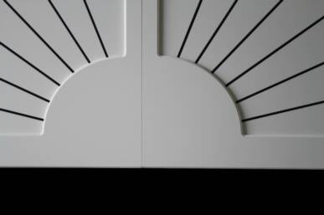
2 Piece Non-Movable Arches & Eyebrow over 59”
Large Arches over 59" will be shipped in two pieces to prevent freight damages. Assembled by just sliding together, our overlapping design assures no light gaps after installation. Show below is an 96" wide Sunburst arch. Wider Arches can be manufactured into three pieces

Slide 10
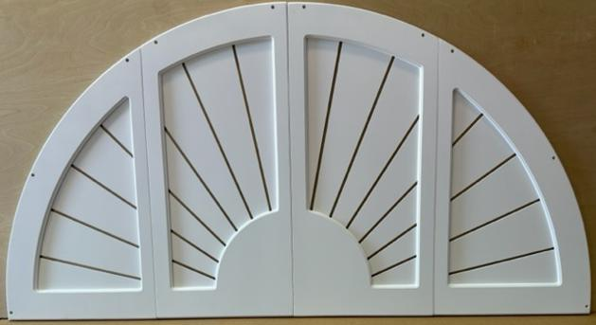
Large Arches & Eyebrows over 72”
Large Arches over 72" will be shipped in two or four pieces to prevent freight damages. Assembled by just sliding together, our overlapping design assures no light gaps after installation. As Shown this four-part non-movable is available in Sunburst and Blackout styles only.

Slide 11
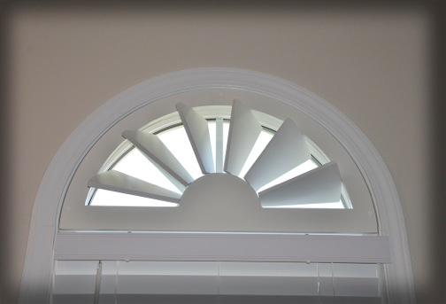
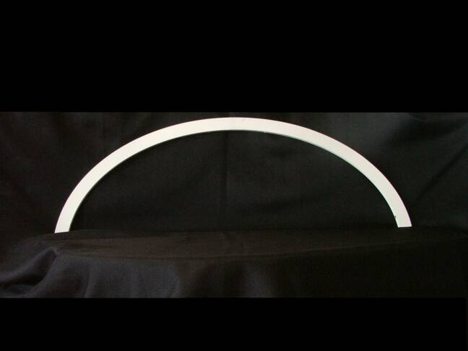
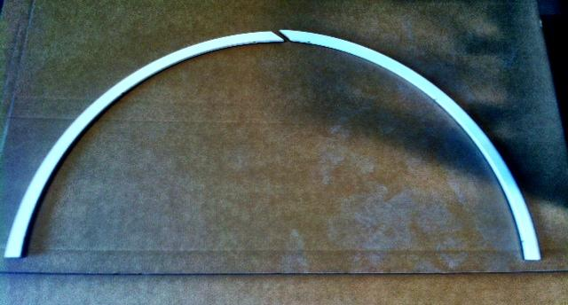
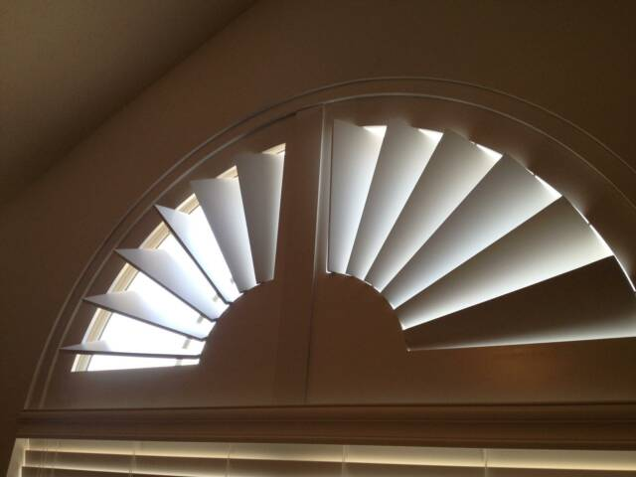
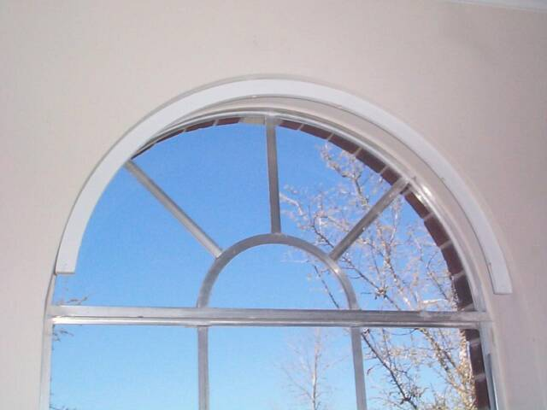
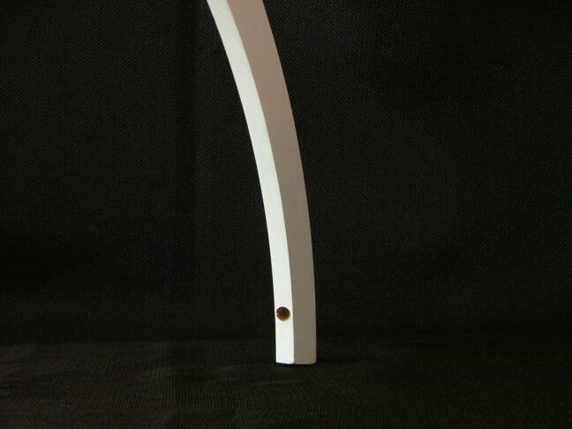
Custom Inside Mounting Strips
All mounting strips are cut to dimensions provided. American Arches will deduct 1/8” inch from all sides of arch to insure proper fit. Any alterations should be made to the mounting strip, not to the arch
1½” wide (mounting strip) x ½” Thick. All mounting strips over 59" will be in 2 parts

Slide 12
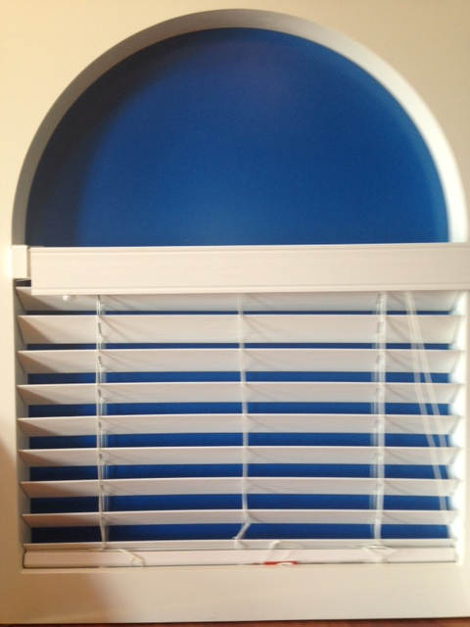
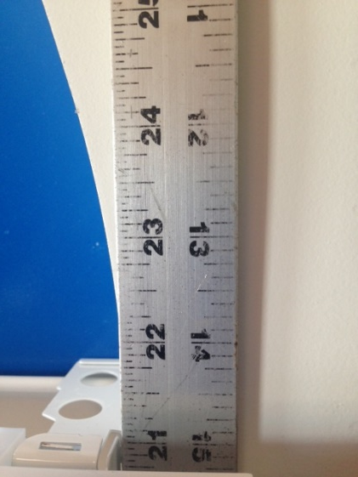
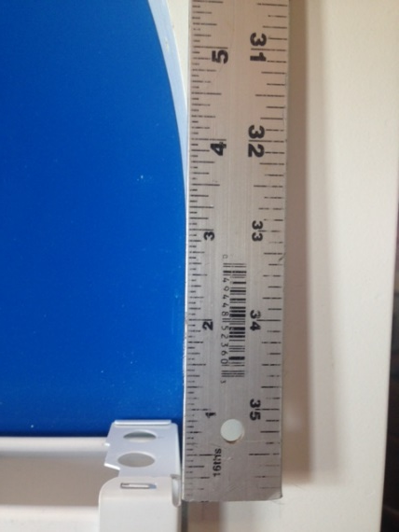
American Arches
The start of the arch Curve is at the top of blind head rail
The start of the arch Curve is approx. 31/2” above the blind (leg)
Top of blind head rail

